Slide 1



Computer Architecture
CS F342
Lecture: Role of Architecture in Chip design an Overview
Date: 12, 17 -01-2024

Slide 2
Processor Chip Design
There are three different aspects (or dimensions) of VLSI chip design
  Functional :
    What function does this chip perform ?
  Structural :
    What is the compositional scheme for this chip ?
    What parts is it composed of ? and
    how those parts have been interconnected ?( the schematic view )
  Physical :
    What is the layout of various physical layers
    that go into the manufacturing of this chip ?
Functional to physical (directly) is a challenge?

Slide 3
Different Abstractions
Each of these three aspects can be viewed at different levels of detail ( called abstraction levels; abstraction is the antonym of detail)
(this is pretty analogous to viewing Google Maps; you may view a larger area with poor details or a smaller area with greater details)
Different abstraction levels present to the designer, at a time, only limited views of the design
  that contains the relevant amounts of detail of the design needed by the designer to work with at that stage of the design.
  The abstraction levels thus serve as a tool-kit to protect the designer from being overwhelmed by unnecessary details of the design

Slide 4
Processor Chip Design
Specification:
VLSI chip design starts with specification of the function to be performed by the chip
  The function can be specified in a natural language (such as English and can run into hundreds of pages, leaving scope for semantic ambiguity and inconsistency)
or
  It can be specified using a formal language ( e.g. ‘C’ , VHDL , Verilog, System ‘C’, System Verilog ), which leaves no scope for semantic ambiguity

Slide 5
Processor Chip Design
Together with the functional specification of a VLSI chip there are also expectations in terms of performance (the speed at which the chip will perform its function) , power consumption , and cost (chip size / gate count )
There are also expectations (or requirements) in terms of functional agility (ability to accommodate changes in chip functionality), time permissible for completing the design and design cost

Slide 6
Processor Chip Design
Architecture:
Architecture design is the very first step in a sequence of steps which constitute the full VLSI design cycle.
In this step a block-level (typically called high-level) compositional scheme, also called block-level schematics, for the chip is conceived to realize the functionality of the VLSI chip, by choosing blocks of simpler functionality and their interconnections.
The chosen blocks may be a mix of combinational and sequential functional blocks as deemed ‘best fit’ by the architect in view of the various other requirements (besides functionality) given to her/him
Architecture design sits at the top of the hierarchy of abstractions used in VLSI design

Slide 7
Processor Chip Design
Multiple Architectural Schemes Possible
Many architectural designs (also often called architectural schemes) can be proposed for a given chip functionality.
All must provide the specified chip functionality; however usually their associated performance (the speed at which it functions), power consumption, chip-cost, and functional agility can differ drastically – making some architecture(s) more favorable than others from the market/user’s perspective.

Slide 8
Processor Chip Design
Architecture design itself usually involves two phases: an architectural planning phase, and a detailed architecting phase (also known as RTL design)
  Planning phase: chooses the high-level building blocks one would like to use in the design (processing elements e.g. ALUs, Multiplier- combinational/sequential, Register file, sequencer FSM, special function units ….) and their interconnection strategy (e.g. buses, muxes, dedicated interconnects …)
  Detailed architecting phase: describes clock cycle by clock cycle functions performed by the processing elements on data supplied by specific storage elements (registers), and storage of the output of processing elements in specific registers
    At the end of the detailed architecting phase one freezes the clock cycle by clock cycle functioning of the chip (but not the duration of the clock cycle or the gate count of the chip; these would be fixed at the logic design stage)

Slide 9
Processor Chip Design
Thus we need to explore multiple architectures and evaluate them (as best as possible at this high abstraction level) before selecting a particular architecture to carry out further detailed design work with
Unfortunately there is no theory that can synthesize an optimal architecture for a given complex functional specification

Slide 10
Architectural Exploration
Architecting is to be learnt from the examples of existing architectures and a set of key architecting techniques that have been developed over the years
Based on this knowledge, and one’s own creativity, an optimal architecture is to be arrived at for the functional specification at hand - usually after some amount of architectural exploration

Slide 11
Architectural Exploration
Architectural design provides the frame-work within which the more detailed design work ( at lower design abstraction levels e.g. gate level, transistor level and layout level ) proceeds
Performance, power and cost of the chip are largely influenced by the architectural choice : They can be tweaked to certain extents by choices made at more detailed design levels ( lower abstraction levels) – but the proverbial die is cast at the architectural level

Slide 12
Architectural Exploration
It is to be noted in particular that a poor ( or plain bad ) architectural choice can not be mitigated / made good for by smarter designing at lower design abstraction levels ( more detailed design levels )
Accordingly, it is of utmost importance that a good architecture is created for a given chip functionality and associated specifications / expectations of performance, power, chip-cost and functional agility

Slide 13
Computer Architecture
The objective of this course is to provide both an overview as well as detailed enough insight into principles and practices of architecting, so that at the end of the course students can apply them creatively to real-life processor architecting for different functional domains and performance
We will begin the overview with an example

Slide 14
Example Architecture
Let the example function to be realized be :
f = a + b + c + d
where a, b, c, and d are n-bit binary numbers
Is this a complete functional specification ? No
Because we haven’t specified the value of ‘n’ and whether the binary numbers are signed or unsigned; we have also not specified as to what is to be done if overflow occurs during the computation

Slide 15

Example Architecture: Combinational Architecture
Architecture 1 : Direct mapping of function onto an architecture
a
+
b
+
c
+
f
d
Function Delay = 3 * Tadd ; Sustained Throughput = @ 3 * Tadd
Energy / Function = 3 * Eadd; Gate complexity = 3 * Gadd
Functional Flexibility = none; Function Expandability = none

Slide 16

Example Architecture: Combinational Architecture
Architecture 2 : Leveraging parallelism inherent in the function
a
+
b
+
f
c
+
d
Function Delay = 2 * Tadd Energy / function = 3 * Eadd
Throughput = @ 2 * Tadd Functional Flexibility = Nil
Gate Complexity = 3 * Gadd Functional Extendability = Nil

Slide 17
Example Architecture: Pipelined Architecture
Architecture 3 : Pipelining: segmenting long combinational logic delay path by inserting registers to increase throughput
a
Dff
+
b
Clk
+
f
c
Dff
+
d
Clk
Function Delay = Tadd + Tsetup + Tclktoq + Tadd
Throughput = @ (Tadd + Tsetup +Thold )
Energy / Function = 2 * Eadd + 2 * Eff + Eadd
Gate complexity = 3 * Gadd + 2 * Gff
Functional Flexibility = None
Functional Expandability = None
Note: A fully pipelined version would have additional D Flip-flops to store
Inputs a, b, c, d and output f

Slide 18
Example Architecture: Functionally Flexible Architecture
Architecture 4 : Introducing functional flexibility in an architecture through the use of multi-functional processing elements
a
b
ALU
ALU
f
C1(3:0)
c
C3(3:0)
ALU
d
C2(3:0)
Function Delay = 2 * Talu Gate complexity = 3 * Galu
Throughput = @ 2 * Talu Functional Flexibility = Full(static)
Energy / Function = 3 * Ealu Functional Extendability = None

Slide 19
Example Architecture: With dynamic functional flexibility
Architecture 5 : Introducing dynamical functional flexibility through the use of multi- functional processing elements and a controller
Function Delay = 2 * Talu Gate complexity = 3 * Galu
Throughput = @ 2 * Talu Functional Flexibility = Full(dynamic)
Energy / Function = 3 * Ealu Functional Extendability = None
a
b
ALU
ALU
f
C1(3:0)
C1(3:0) C2(3:0) C3(3:0)
c
C3(3:0)
ALU
control
d
C2(3:0)

Slide 20

Example Architecture: Sequential Architectures
Architecture 6 : A sequential architecture (Reducing the number of Processing Elements by ‘reusing’ a single processing element to sequentially perform operations on different sets of data inputs )
This ‘reuse’ necessitates the storing of results of each operation so that they are not lost when a new set of inputs is applied to the processing element.
Also you need data routing interconnections among processing elements and storage elements.
Control signals are also required to be generated and applied to control this routing of data in different sequential steps
a
b
MUX
ADD
c
DFF
d
CLK
CONTROL

Slide 21
Example Architecture: Sequential Architectures
Sequential architectures economize on the use of processing elements(by avoiding their replication).
But they incur over-heads in terms of storage elements, controller logic and data-routing circuitry (both in terms of their gate counts and energy consumption per operation).
Sequential architectures are much better suited when the processing element (which is a combinational logic circuit) is complex and occupies much larger area than a storage element.
In those situations a sequential architecture can provide huge area advantage over the approach of direct mapping of algorithms on to an architecture, with only a small degradation in speed and a small increase in energy per function or power.

Slide 22
The Search for Reusable and Universal Architectures
Question: Can an architecture created for implementing one function be leveraged for implementing a completely different function ? This would surely save time for implementing a new function
Question: Can one think of an architecture which can implement any function by modifying just one block in a ‘standard’ architectural template – without touching any other block ?
Question: Daring to think further, can there be an architectural scheme / template in which no hardware modification of any block is required to implement any function ? A universal architecture that does not need to be changed for implementing any specified functionality !!

Slide 23
Example Architecture: Sequential Architectures
A Sequential architecture plan (with expandability) which requires only the control part redesign to achieve universal functionality.
RAS:
Random Access Storage with
two read and
one write ports
RAS/RF
ALU
CONTROL:
Generates addresses
and control signals for the two Read and one Write ports of RAS
control

Slide 24
Example Architecture: Sequential Architectures
A Sequential architecture plan (with expandability) which requires only the control part redesign to achieve universal functionality.
This architectural plan can be converted into a detailed architecture design by including a mux and two registers at the inputs of the ALU and a register at the output of the ALU, and, a register to hold the outputs of the control block.
One can then work out the sequence of register transfers that would need to be performed (in successive clock cycles) to implement the full functionality
RAS/RF
ALU
Control

Slide 25
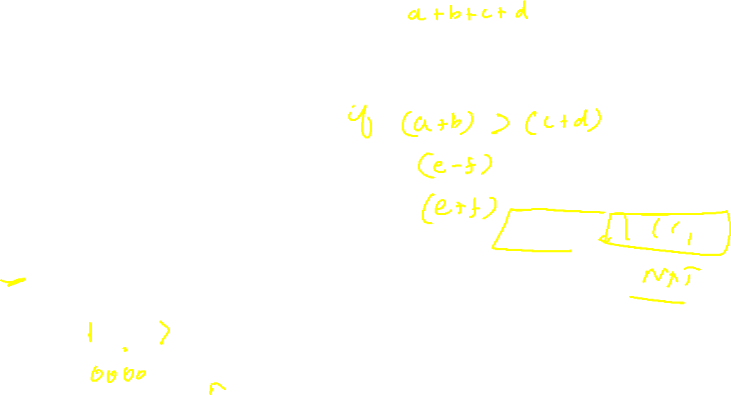
Example Architecture: Universal Sequential Architecture
Universal architecture with full functional flexibility and functional expandability (requires no change to implement any function):
ALU with 2 input and 1 output
Universal architecture that can sequentially realize any function without requiring any change In any part of hardware. Here not only the processing element has functional flexibility, the control sequence generator also has flexibility (alterable through the ability to alter the sequence of control words stored in the control memory that are sequentially fetched and applied by the control sequence generator)
Registers
Control
Memory/
store
Control
sequencer

Slide 26
Example Architecture: Instruction Set based Architecture
Universal architecture with full functional flexibility and functional expandability:
This is a more convenient universal architecture that can sequentially realize any function without requiring any change In any part of the hardware.
A convenient binary instruction set is defined that specifies as to which data-memory locations are to be accessed for data, then how that data is to be processed, and at what data memory location the result is to be stored back into the memory, following which from what address in the instruction memory the next instruction is to be fetched. Given an instruction set, the control part is designed to generate the sequence of control signals required for executing any instruction from the instruction set. The user describes his computation as a sequence of instructions and loads this sequence in the memory.
Data
Memory
ALU and Registers
Control
Part
(ID)
Instruction
Memory

Slide 27
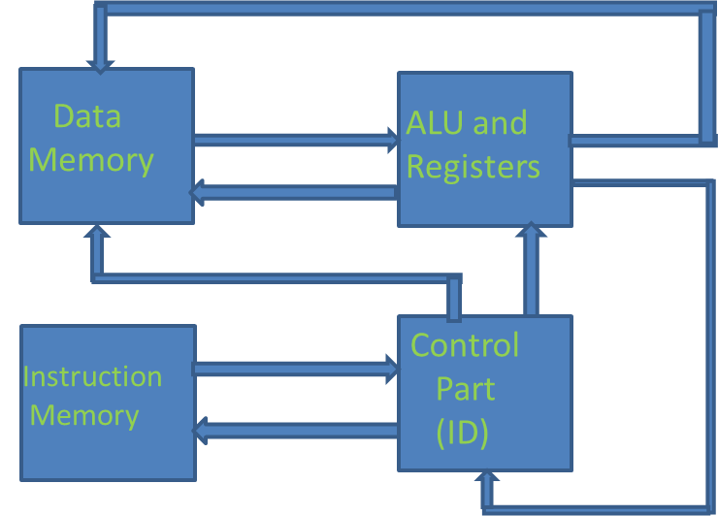
Example Architecture: Instruction Set based Architecture
Universal architecture with full functional flexibility and functional expandability:
This architectural scheme only illustrates the essence of the architectural idea behind a Stored Program Digital Computer (the universal computing machine). In practice its implementations have many a finer aspects to them such as the use of only a single memory to store both instructions and data versus the use of two separate memories for instruction storage and data storage; organizing memory (memories) in a hierarchy for achieving higher speed and lower power consumption, and the issues associated with managing this hierarchy;
the use of multiple processing elements in place of a single ALU; the use of pipelining and parallelism in processing elements as well as memory hierarchies, to increase the instruction throughput, while maintaining sequential semantics of instruction execution. We will look at some of these aspects in detail in the context of design of a single chip CPU ( e.g. the microprocessor)

Slide 28

Thank You

